Slide 1
Microprocessor System Design
Timers
Omid Fatemi
(omid@fatemi.net)

Slide 2
Outline
Timers / counters / Watchdog timers
8253/4 description
Programming the counters
8253 in a PC
Generating sound
Various modes of operation

Slide 3
Timers, counters, watchdog timers
Timer: measures time intervals
  To generate timed output events
    e.g., hold traffic light green for 10 s
  To measure time between events
    e.g., measure a car’s speed
Based on counting clock pulses
    E.g., for a 100 MHz clock, Clk period would be 10 ns
    And we count 20,000 Clk pulses
    Then 200 microseconds have passed
    16-bit counter would count up to 2¹⁶ = 65,535*10 ns
    ➔ 655.35 μs (range), with a resolution of 10 ns
    Top: indicates top count reached, wrap-around
    How can we measure a time interval larger than the range?
Basic timer
Clk
16-bit up counter
16
Cnt
Top
Reset
cnt: # of clock pulses since the counter
was last reset (set to zero).

Slide 4
Counters
Counter: like a timer, but counts pulses on a general input signal rather than clock
  e.g., count cars passing over a sensor
  We can often configure device as either a timer or counter
  Counters and timers can be combined to measure rates, such as the speed of a car (# of times wheel rotates in one second).
Timer/counter
Clk
2x1 mux
16-bit up counter
Cnt
16
Cnt_in
Top
Reset
Mode

Slide 5
Other timer structures
Interval timer
  Indicates when desired time interval has passed
  We set terminal count to desired interval
    Number of clock cycles = Desired time interval / Clock period
    If f_{clock}=100 MHZ, how many times do we need to count to reach 3μs?
    Top both resets the counter, and informs us when the count is up. It is typically connected to an interrupt.
    We can also set the count back from terminal count to zero.
Cascaded counters
Prescaler
  Divides clock
  Increases range, decreases resolution.
16/32-bit timer
Clk
16-bit up counter
Cnt1
16
Timer with a terminal count
Top1
Clk
16-bit up counter
Cnt
16
16-bit up counter
16
Cnt2
Reset
Top2
=
Which one has lower significant bits?
Top
Terminal count
Time with prescaler
Clk
Prescaler
16-bit up counter
Enable/disable count
Enable/disable interrupt
Determine dividing factor
Etc.
Mode

Slide 6
Example: Reaction Timer
indicator light
reaction button
/* pseudocode */
#define MS_INIT 63535
void main(void){
int count_milliseconds = 0;
configure timer mode
set Cnt to MS_INIT
wait a random amount of time
turn on indicator light
start timer
while (user has not pushed reaction button){
if(Top) {
stop timer
set Cnt to MS_INIT
start timer
reset Top
count_milliseconds++;
}
}
turn light off
printf(“time: %i ms“, count_milliseconds);
}
LCD
time: 100 ms
Measure time between turning light on and user pushing button
  16-bit timer, clk period is 83.33 ns (12 MHz), counter increments every 6 instruction cycles
  Resolution = 6*83.33=0.5 microsec (too high).
  Range = 65535*0.5 microseconds = 32.77 ms (too low for this application)
  Want program to count 100s of ms, w/o a prescalar, how the extend the range…?
  Initialize timer such that it will overflow in 1 ms, then count the number of overflows!
    1 ms➔1 ms/(0.5 μs/inst.cycle) ➔2000 inst. cycles
    so initialize counter to 65535 – 2000 = 63535
    Counts from 63535 → 65535 in 1 ms ➔ overflow
    What inaccuracy does this solution have?

Slide 7
Watchdog Timer
Instead of timer generating a signal every X time units, we must reset timer every X time unit, else timer generates a signal (time-out!)
Under normal operation, we deliberately reset the watch-dog timer every so often.
Timer out is typically connected to the μP interrupt in. Common use: detect failure, self-reset
11-bit
up-counter
16-bit
up-counter
÷12
osc
clk
overflow
overflow
prescaler
scalereg
timereg
to system reset
or interrupt
checkreg
/* main.c */
main(){
wait until card inserted
call watchdog_reset_routine
while(transaction in progress){
if(button pressed){
perform corresponding action
call watchdog_reset_routine
}
/* if watchdog_reset_routine not called every < 2 minutes, interrupt_service_routine is called */
}
watchdog_reset_routine(){
/* checkreg is set so we can load value into timereg. Zero is loaded into scalereg and 11070 is loaded into timereg */
checkreg = 1
scalereg = 0
timereg = 11070
}
void interrupt_service_routine(){
eject card
reset screen
}
  ➔ timereg range: 2*(2¹⁶-1)=131070 ms
  ➔ timereg = 11,070
Notes:
We want to make watchdog for every 2 minutes. (bank machines)
EP users typically do not have access to an external reset/reboot, hence such systems must be able to reset in case of malfunction.
Example: ATM time-out
12 MHz oscillator freq. / 12 = 1MHz
1 Mhz * 2^11 = 2 ms
timereg is incremented every
12*2¹¹*1/(osc)=2 ms
16-bit timer, 2 ms resolution
timereg value = 131070–X
For 2 minute time-out,
X = 120,000 ms

Slide 8
8253/54 Chip
Main function:
  Dividing clock frequency
Three counters
Models
  8253: 2 MHz
  8254: 8 MHz
  8254-2: 10 MHz

Slide 9
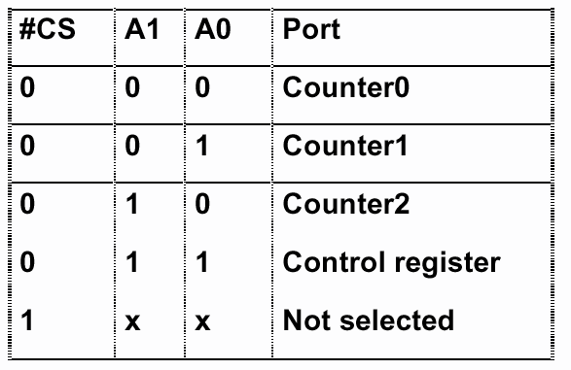
Addressing 8253

Slide 10
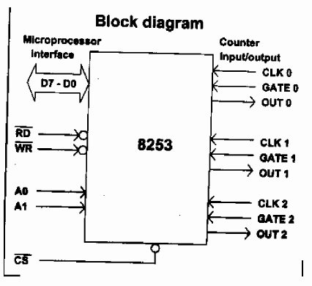
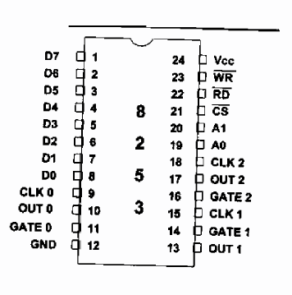
Pin Description

Slide 11
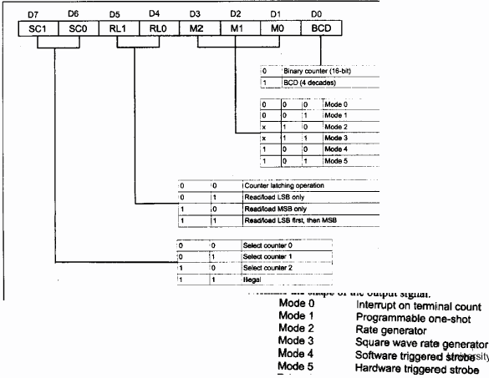
Control Word

Slide 12
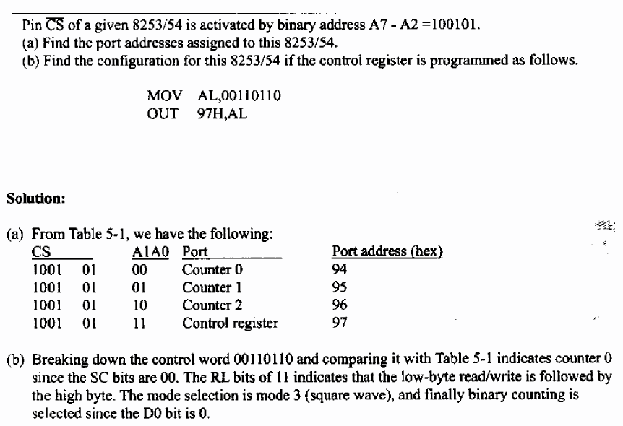
Example

Slide 13
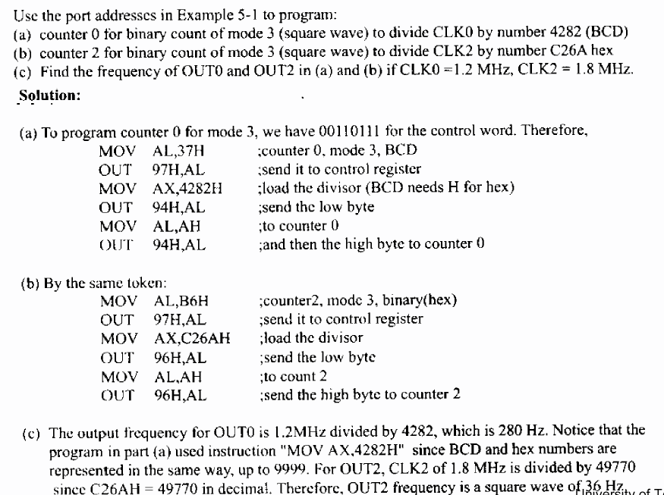
Example 5-2

Slide 14
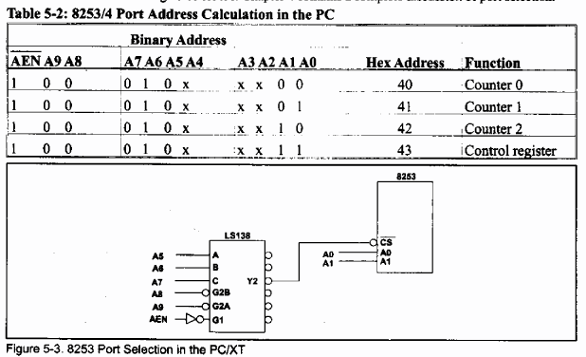
8253 Decoding in PC

Slide 15
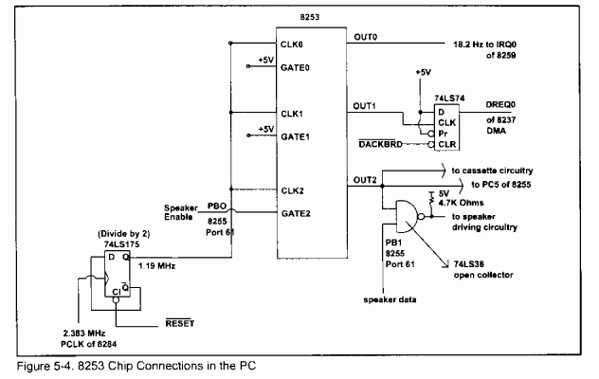
PC Board

Slide 16
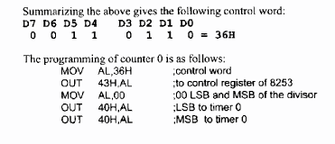
Timers in PC
Counter 0
  IRQ0 – TOD (time of day)
  18.2 Hz (1.193 MHz / 65536)
  Mode 3, control word: 36H
Counter 1
  DRAM refresh – using DMA (at least every .015ms)
  2 ms / 128 rows = .015 ms (.015ms = 66278Hz→1.193/18)
  Mode 2, control word: 54H
Counter 2
  Speaker and PC5
  896 Hz (1.193MHz / 1331)
  Mode 3, control word: B6H
  GATE2 is connected to PB0 (port 61H)

Slide 17
Time Delay in PC
Using software
    MOV CX, N
    AGAIN: Loop AGAIN (17 clock cycles)
  More than N * T(210ns) * 17
    SUB CX,CX
    G7: Loop G7 (234ms or better 250ms)
    DEC BL
    JNZ G7
Hardware
  PB4 of port 61H toggle every 15.085 micro
  Delay.com program

Slide 18
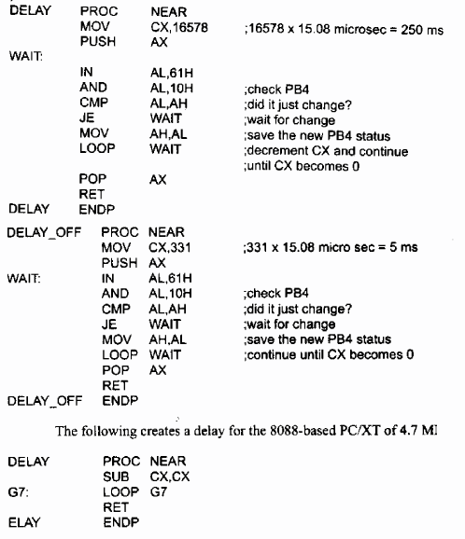
Music Using Beep

Slide 19
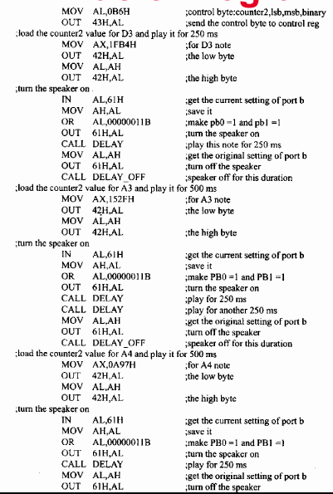
Music Program
D3 note
A3 note
A4 note
Notes:
D is for Re
A is for La

Slide 20
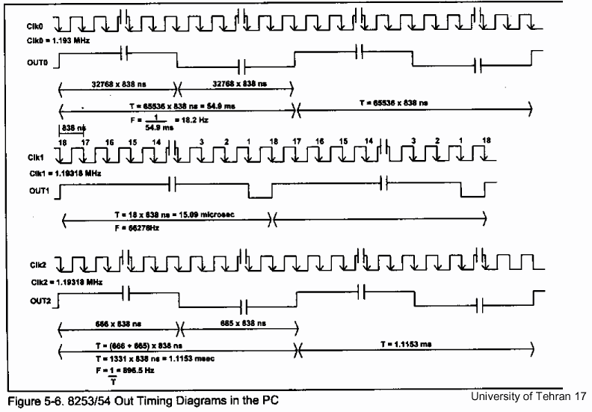
Output Shapes in PC

Slide 21
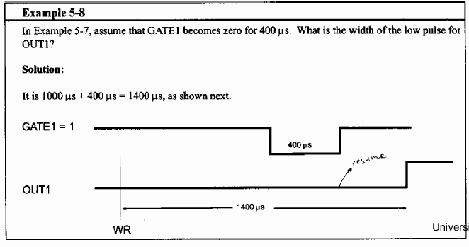
Mode 0
Interrupt on terminal count
Low for N*T then high (Remain high until new control word or count number)

Slide 22
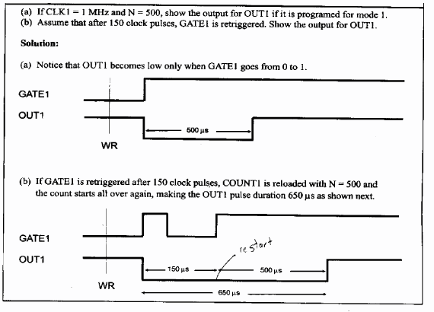
Programmable One Shot (mode 1)
Programmable one-shot (hardware triggerable one shot)
0 to 1 on GATE (low for N*T)

Slide 23
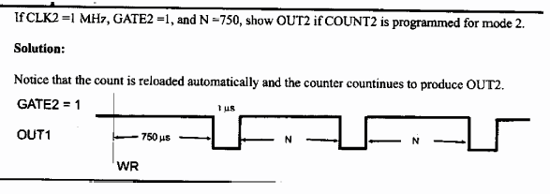
Rate Generator (mode 2)
Rate generator (divide by N counter)
High for N*T and low for 1*T
As long as GATE

Slide 24
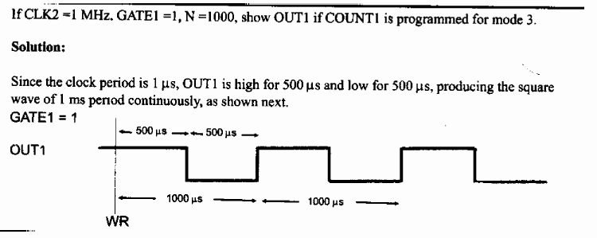
Square Wave (Mode 3)
Square wave rate generator
Low N/2 high N/2 ((N+1)/2 if N odd)

Slide 25
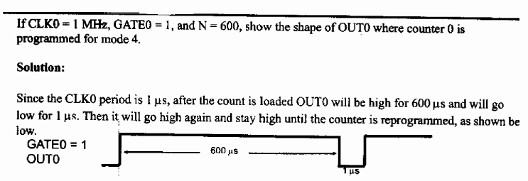
Mode 4
Software triggered strobe
Starts upon loading the count
High for N*T low for 1 and then high

Slide 26
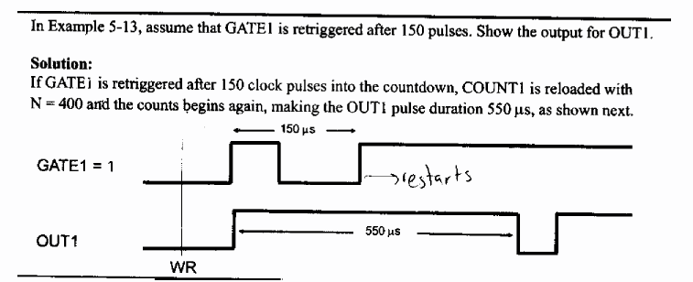
Mode 5
Hardware triggered strobe
0 to 1 pulse on GATE

Slide 27
Exercises from Book
Text book, Vol. 2 (Page 189-191)
Problems 3, 8, 18, 20, 29

